Slide 1
Wanderers of the Rift
WEEKLY UPDATE
2025/03/08
Anyone want to make a template for us to use going forward? This was just the first template that jumped out at me

Slide 2
AGENDA
Kudos & Recognition
Name Poll Results and What’s Next
MVP Updates
Demo/Upcoming Milestones
Miscellanea
Q&A

Slide 3
Kudos &
Recognition
Art by: Wh413

Slide 4
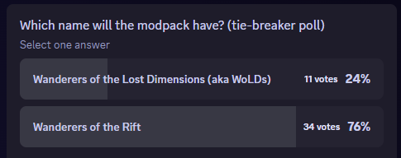
NAME POLL RESULTS
Round 2 (tie-breaker) for Name Poll:
Changes will happen slowly.

Slide 5
UPCOMING POLLS/COMMUNITY UPDATES
Durability Vote
Do we want Durability in the Game and to what extent?
Yes, remove durability completely
Yes, but only remove for WotRift items
No, durability should stay
Choice explainer: https://dimension-delvers.github.io/dimension-delvers-docs/polls/durability.html
Poll Guidelines available on mdBook

Slide 6
UPCOMING POLLS/COMMUNITY UPDATES
Enchanting
Do we want Vanilla-like Enchanting in the Game and to what extent (came up thinking about Durability)?
Discussion in Forums ongoing: https://discord.com/channels/1328761294085554176/1347962994335809546
(discussion is part of the process, explained later)

Slide 7
MVP Updates
Art by: Wh413

Slide 8
ROOMS AND POIs
We currently have 2 rooms and one POI. More needed, to be done on the build server
Processor handles block conversion, Patrigan can help with how to leverage its use

Slide 9
MISCELLANEA
Decision Process
Discussion in voice or chat
Idea polishing in Forums (for easy retrieval based on topic)
Polling for options (need more than 2)
Guidelines / Results published on mdBook once decision is taken.
Changes / Actions timelines depending on decisions

Slide 10
DEMOS

Slide 11
Q&A

